Slide 1
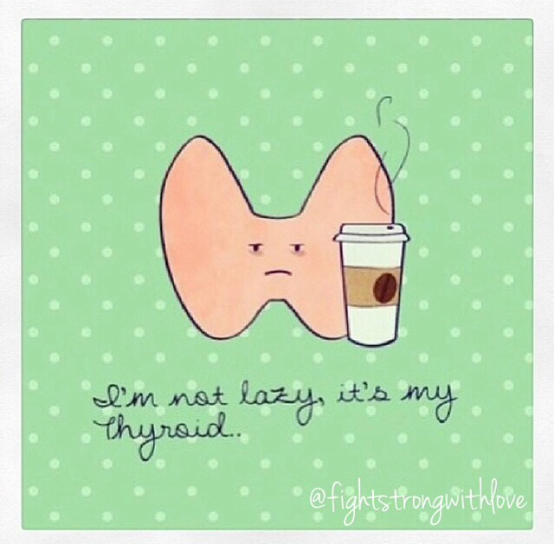
Understanding Thyroid Function & When To Refer
Haley Smith, CPNP
Dr. Lindsey Waldman, MD, RD
Pediatric Endocrine
Pediatric Specialists of Virginia

Slide 2
Disclosure
We have no relevant financial disclosures

Slide 3
Objectives
Understand thyroid function and regulation
Recognize hypothyroidism and hyperthyroidism
Identify when a patient should be referred to endocrine

Slide 4
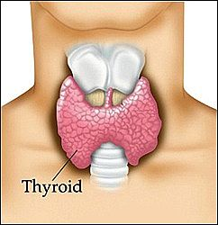
Thyroid Functional Anatomy
Butterfly shaped gland
Located in anterior neck
Highly vascular
Consists of right lobe and left lobe, connected by the isthmus
Usually non palpable

Slide 5
Thyroid Regulation
Thyroid function maintained through the hypothalamic- pituitary- thyroid axis (HPT)
Hypothalamus secretes thyroid releasing hormone (TRH)
TRH signals the pituitary to make thyroid stimulating hormone (TSH)
TSH signals production of thyroxine (T4) & triiodothyronine (T3) from the thyroid
Circulating thyroid hormone give negative feedback to hypothalamus and pituitary
Notes:
Thyroid hormones are like heat. When the heat gets back to the thermostat, it turns the thermostat off

Slide 6
Thyroid Regulation
Circulating thyroid hormone bound to thyroxine-binding globulin (TBG)
The unbound (free) hormone is active
Only ~1% of thyroid hormone is unbound & free to carry out thyroid function
Thyroid gland is the sole source of T4
80% of T3 is derived from peripheral (hepatic & renal) monodeiodination of T4 to T3

Slide 7
Actions of Thyroid Hormone
Growth and development
Oxygen consumption and heat production
Nerve function
Metabolism of lipids, carbohydrates, proteins, nucleic acids, vitamins, and inorganic ions

Slide 8
Thyroid Exam

Slide 9
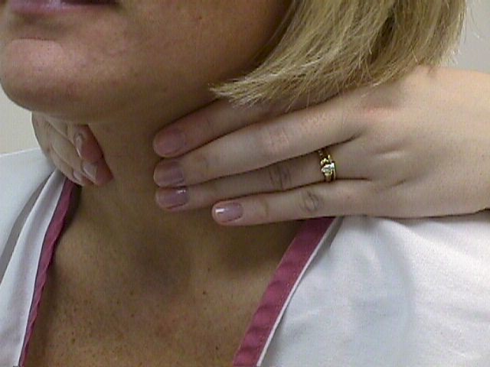
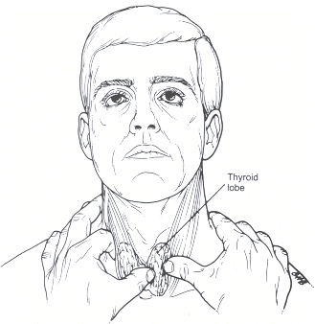
Palpation

Slide 10
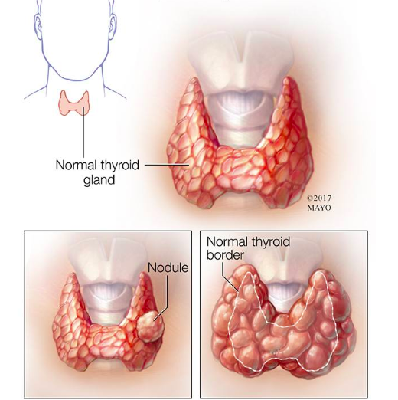
Exam findings
Abnormal findings:
Goiter/thyroid enlargement
Thyroid gland asymmetry
Tenderness
Focal firm consistency (nodule)
With abnormal findings consider thyroid function tests and ultrasound & refer to endo
Just because it is “enlarged” DOES NOT mean there is a problem!!

Slide 11
Thyroid Imaging
Thyroid Ultrasound
In congenital Hypothyroidism: evaluate if thyroid is dysmorphic, ectopic, aplastic
Evaluate thyroid nodules and masses
Goiter size; distortion of surrounding tissues
Thyroid Nuclear Scan
Functional study to measure iodine uptake of the thyroid gland and possible organification defects

Slide 12
Thyroid Function Tests
TSH
Normal range= 0.35-5 uIU/mL
Free T4
Normal range= 0.90 -1.67 ng/dL
Total T3
Normal range= 86-192 ng/dL
Thyroglobulin Antibody
Normal range= <1 IU/mL (negative)
TPO
Normal range= <9 IU/mL (negative)
Specific to Hashimoto
TSI
Normal range= <140 % baseline (negative)
Specific to Grave’s

Slide 13
Thyroid Hormone Dysfunction
Hyperthyroidism
Autoimmune; Grave’s Disease
Hashitoxicosis
Medication induced
Lithium
Amiodarone
Euthyroid Sick Syndrome (transient)
Hypothyroidism
Acquired
Autoimmune (Hashimoto’s)
Surgery
Radiation/medications
Iodine deficiency/excess
Congenital
Thyroid dysgenesis
Ectopic
Dyshormonogenesis
Iodine deficiency/excess
Hypopituitarism

Slide 14
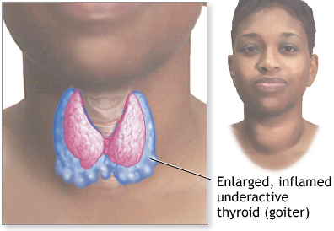
Hashimoto’s Hypothyroidism

Slide 15
Overview of Acquired Hypothyroidism
TFTs
Elevated TSH
TSH>10 in pediatrics!!!
Normal/Low free T4
TPO antibody usually positive in Hashimoto’s
Most common cause in US is Hashimoto’s Thyroiditis (autoimmune form)
Iodine deficiency is most common cause world wide
Rare in the US

Slide 16
Signs of hypothyroidism
Poor growth in height
Weight gain
Lethargy/extreme fatigue
Poor concentration
Constipation
Weakness
Symptoms can be non-specific to just thyroid conditions

Slide 17
Clinical Presentation
Hashimoto’s
General appearance: lethargic, tired appearing, possible weight gain, poor height gain
Behavioral Changes: decline in school performance, poor concentration, increased time spent sleeping
Thyroid: may be diffusely enlarged with somewhat firm consistency
Vital signs: usually stable/within normal limits
Integumentary: generalized dry skin, brittle/thinning hair

Slide 18
Treatment Guidelines
Endocrine society recommendation for treatment initiation: TSH >10 uIU/ml
Standard treatment for hypothyroidism is Levothyroxine
Age Dose (mcg/kg)
0-3 months 10-15
3-6 months 8-10
6-12 months 6-8
1-3 years 4-6
3-10 years 3-5
>10 years 2-4
Subclinical Hypothyroidism does not require immediate treatment
Elevated TSH 5 uIU/mL - 7.5 uIU/mL on initial testing may normalize without treatment
Pre-existing obesity may cause transient, mild increase in TSH
Does not require treatment and may improve with weight loss!

Slide 19
Testing Recommendations
Borderline TSH elevation (5 uIU/mL -10 uIU/mL ):
May consider repeat TFTs in 3 months
Does not necessitate urgent referral
TSH elevation >10 uIU/mL
Refer
Concern of corresponding goiter- refer!
Concern of corresponding poor/delayed growth- refer!
When in doubt, call endo!
Thyroid Antibodies
Add antibodies levels for any abnormal TFTs
If + antibodies with normal TFTs, no treatment needed
Repeat TFTs every 6 months, refer if TFTs become abnormal
Antibodies only increase risk of dysfunction

Slide 20
Congenital Hypothyroidism
TSH is initially measured on newborn screen.
TSH > 40 flagged as abnormal
NB screen should be drawn at 24 hours of life or later
Early discharge of mother/baby may result in false positive testing
Confirm all abnormal newborn screens with laboratory TSH and free T4 (regardless of symptoms)
Concerning symptoms: puffy face, hypotonia, large tongue, poor feeding
Early intervention is critical
Untreated could lead to mental retardation and stunted growth

Slide 21
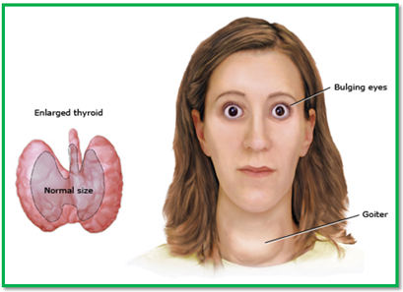
Hyperthyroidism

Slide 22
Overview of Hyperthyroidism
TFTs
Suppressed TSH (<0.01 uIU/mL)
Elevated free T4, total T3, free T3(may be normal in early disease)
TSI antibody & TSH Receptor Antibody positive in Grave’s
Causes
Autoimmune; Grave’s Disease
Hashitoxicosis
Medication induced
Lithium
Amiodarone
Euthyroid Sick Syndrome (transient)

Slide 23
Signs of Hyperthyroidism
Weight loss
Palpitations
May be reported as “anxiety”
Poor sleep
Diarrhea
Tremor/jitteriness
May be reported as “hyperactivity” in younger children
Tachycardia
Widened pulse pressure (elevated systolic, normal diastolic)

Slide 24
Treatment Guidelines: Meds
Methimazole (MMI)
Preferred
Baseline CMP & CBC before initiating (HCG in adolescent female)
May cause agranulocytosis and/or cholestatic disease
CBC and LFT’s should be monitored if symptoms
May cause skin reaction, arthralgia (stop MMI)
CBC should be checked if patient develops fever, mouth sores, pharyngitis, or malaise
Propylthiouracil (PTU)
Not recommended as standard of care in children
High risk of liver failure in children
Can be used for a short time if patient has an adverse reaction to MMI and cannot get ablation or surgery urgently.
Consider adding Beta Blocker for symptom management

Slide 25
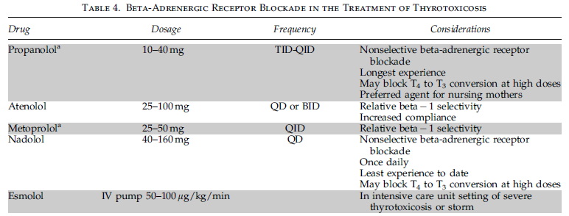
Treatment Guidelines: Beta Blockers
Temporary use of beta blocker may be necessary initially
Used to treat symptoms until thyroid function normalizes

Slide 26
Treatment Guidelines: Definitive
Definitive Treatment (AKA surgery or radiation):
Recommended if not able to tolerate medical management, considering pregnancy, or if no signs of remission after 2 years
Committed to treatment with levothyroxine for life
Surgical Thyroidectomy – need experienced surgeon
Risk to recurrent laryngeal nerve
Risk of removal of parathyroid glands (hypocalcemia)
Radioactive Iodine Ablation
Few long term studies in children/adolescents
Concerns about long term risk for secondary malignancy
Can damage salivary glands
Should be avoided in children <5 years and is not preferred for children < 10 years

Slide 27
Testing Recommendations
If symptomatic- obtain TFTs and antibodies.
Abnormal exam findings & abnormal TFTs- refer
Hyperthyroidism often initially misdiagnosed as anxiety
Additional Evaluation to consider:
EKG +/- Echocardiogram
Ophthalmology (visual fields)
Baseline CBC and CMP
Psych referral if normal TFTs & anxiety

Slide 28
Other Diagnostic Considerations
Hashitoxicosis
Characterized by transient hyperthyroidism, followed by hypothyroidism
Inflammation causes temporary release of excess thyroid hormone (T4)
Initial suppressed TSH, but with negative Grave’s antibodies
Does not always require treatment in hyperthyroid phase
Would start levothyroxine once overtly hypothyroid
Could add beta blocker initially if symptomatic
Ultrasound & Thyroid uptake and scan may be helpful in differentiating
Refer to endo
Non thyroidal illness ( “euthyroid-sick syndrome”)
Seen in critically ill
Serum T3 is low (↓ peripheral T4→ T3)
FT4 normal (or slightly elevated)
TSH low during illness, typically rises during recovery
Thyroid replacement therapy not indicated for non thyroidal illness

Slide 30
Patient 1
15 year old, Female
Presents to clinic today with chief complaint(s) of:
Weight gain (reported 10 lbs in last 4 months)
Increased hair loss
Recent increased fatigue
Past medical history of
Depression, anxiety
Obesity, BMI has always fluctuated between 95-98%-ile
Menarche age 13, monthly periods
Poor sleep hygiene: goes to bed 12am, wakes up 7am for school. Plays video games before bed
Does well in school, A-B student
Denies bowel changes, CV changes, temperature intolerance

Slide 31
Patient 1
Physical exam:
BP: 123/86, HR: 95, wt: 81.6 kg, hgt: 66 in, BMI 96%
On exam:
Patient is obese and looks fatigued
No hair thinning appreciated
Thyroid non-palpable
Exam otherwise normal
What do you want to do?
Notes:
TFTs
Diet counseling

Slide 32
Patient 1
Labs are back
Test | Result | Reference
TSH | 6.1 | 0.34-5.60 uIU/mL
Free T4 | 0.85 | 0.6-1.1 ng/dL
Thyroglobulin Ab | <1 | 0-4.1 U/mL
TPO Ab | <1 | 0.0-5.6 IU/mL

Slide 33
Patient 1
Plan:
Counsel on diet and exercise
Counsel on sleep hygiene, limiting screen time (especially before bed)
May consider psych referral for hx anxiety
No need to repeat TFTs!!!
No endo referral needed
Reasoning
Pre-existing obesity may cause transient, mild increase in TSH
Does not require treatment and may improve with weight loss!
Hair loss may be related to excessive hair treatment, anxiety

Slide 34
Patient 2
10 year old, Male
Presents to clinic today with chief complaint(s) of:
New onset anxiety
Mom feels frustrated because he wont ever sit still!
Trouble concentrating in school, recent decline in grades
Mom concerned that “maybe he has ADHD?”
Pt reports often feeling “butterflies in his chest”
Past medical history of
No significant history
Previously very good student
Family history of Hashimoto’s thyroiditis

Slide 35
Patient 2
Physical exam:
BP: 143/90, HR: 124, wt: 42.3 kg, hgt: 62.4 in, BMI 52%
On exam:
Patient is thin and very anxious. 10 lb weight loss since last measured.
Poor eye contact, fidgeting and playing with exam table paper
Fine hand tremor appreciated
Diffusely enlarged thyroid gland
Increased patellar reflexes
What do you want to do?
Notes:
Call endo
Labs
Beta blocker

Slide 36
Patient 2
Plan
Call endo ☺
Orders
TSH, FT4, TT3, TG AB, TSI, TSH Receptor AB drawn and sent
Start beta blocker for symptoms while labs pending

Slide 37
Patient 2
Labs are back!
Diagnosis: Grave’s disease
Seen by endo and started on Methimazole
Endo can consider thyroid imaging as needed
Test | Result | Reference
TSH | <0.01 | 0.34-5.60 uIU/mL
Free T4 | 3.60 | 0.6-1.1 ng/dL
Total T3 | 328 | 87-178 ng/dL
Thyroglobulin Ab | 136.8 | 0-4.1 U/mL
TSI | 378 | 0-139 %
TSH Receptor Ab | 3.34 | </=1.75 IU/L

Slide 38
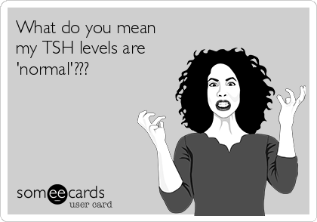
Questions??

